Slide 1
WEL-COME

Slide 2

TECHNICAL PRESENTATION ElectroWorld (Marketplace)
PRESENTED BY
Kiran Fand Roll No. 233045
Mandar Shetty Roll No. 233050
MENTORED BY
Prof. Mrs. Megha Mane
Group no. 27
Post Graduate Diploma in Advanced Computing (PG-DAC)
MARCH-23
Institute for Advanced Computing & Software Development
Nigdi, Akurdi, pune, Maharashtra 411044

Slide 3
Introduction
E-commerce, which is now an integral part of many businesses, is used primarily to boost sales revenue, to attract new customers and to survive in today’s competitive business environment.
Also, it has benefitted the customers as they now have easy access to a wide range of goods and services at anytime and anywhere in the world.
The Marketplace provide the facility to vendors for managing their products through seller-login, while the customers will be able to order and pay for products through customer login.
The admin will be able to manage vendors, products, customers and orders through admin login after the verification of seller admin can make approval of particular vendors on Marketplace.
In this system only verified vendors can be able to make their profile, for each profile they have to pay for registration charges which are depends on package that they select. Furthermore, there will be an email notification after completing an order.

Slide 4



User Classes
Admin
Sellers
Customer
Seller can add/edit/ remove Products
Customer can add products to cart and buy Products
In this module Admin can manage sellers and customers and Fetch daily orders

Slide 5
Technology Used
We used Java Spring-Boot as backend and React JS as Frontend in our Project.
❖ Spring-Boot :
The main goal of the Spring Boot framework is to reduce overall development time and increase efficiency. React has become the first choice for frontend because it gives developers the ability to work with a virtual browser (more friendly than the real browser). Also, a JavaScript developer can become a productive developer in a few hours because there is a small API to learn, a few functions, and how to use them.
❖ React :
React allows developers to create large web applications that can change data, without reloading the page. The main purpose of React is to be fast, scalable, and simple.
❖ MySql Database :
MySQL is globally renowned for being the most secure and reliable database management system used in popular web applications
MySql supports relational data to store in tabular format. so that we can access it very easily. .

Slide 6
Project Funtions
The (Marketplace) ElectroWorld is Web application. It is intended to provide online solution for marketplace staff, venders as well as consumers as one stop solution platform using internet.ElectroWorld will enable sellers to set up online store.
Customers will be able to purchase products through virtual store. ElectroWorld would perform online business process automation such as one Shopping Cart management, Order Processing , Payment Processing, Customer Relationship Management as well as Shipment.
Online shopping is a form of electronic commerce which allows consumers to directly buy goods or services from a seller over the Internet using a web browser or a mobile app.

Slide 7
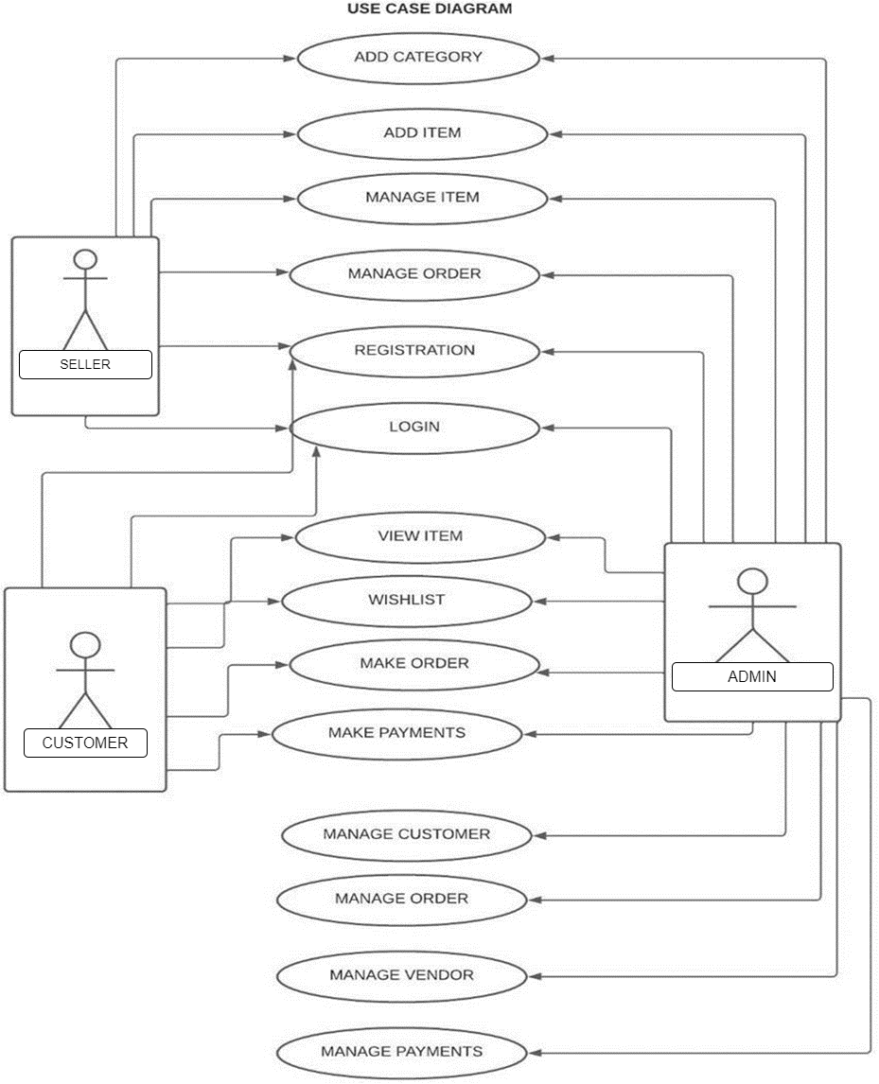
Use case Diagram:

Slide 8
Admin Module
Login of Admin
The system will allow the Admin to view the details of Seller as well as add and remove them.
The system will allow the Admin to view the Customers and Customer’s order.

Slide 9
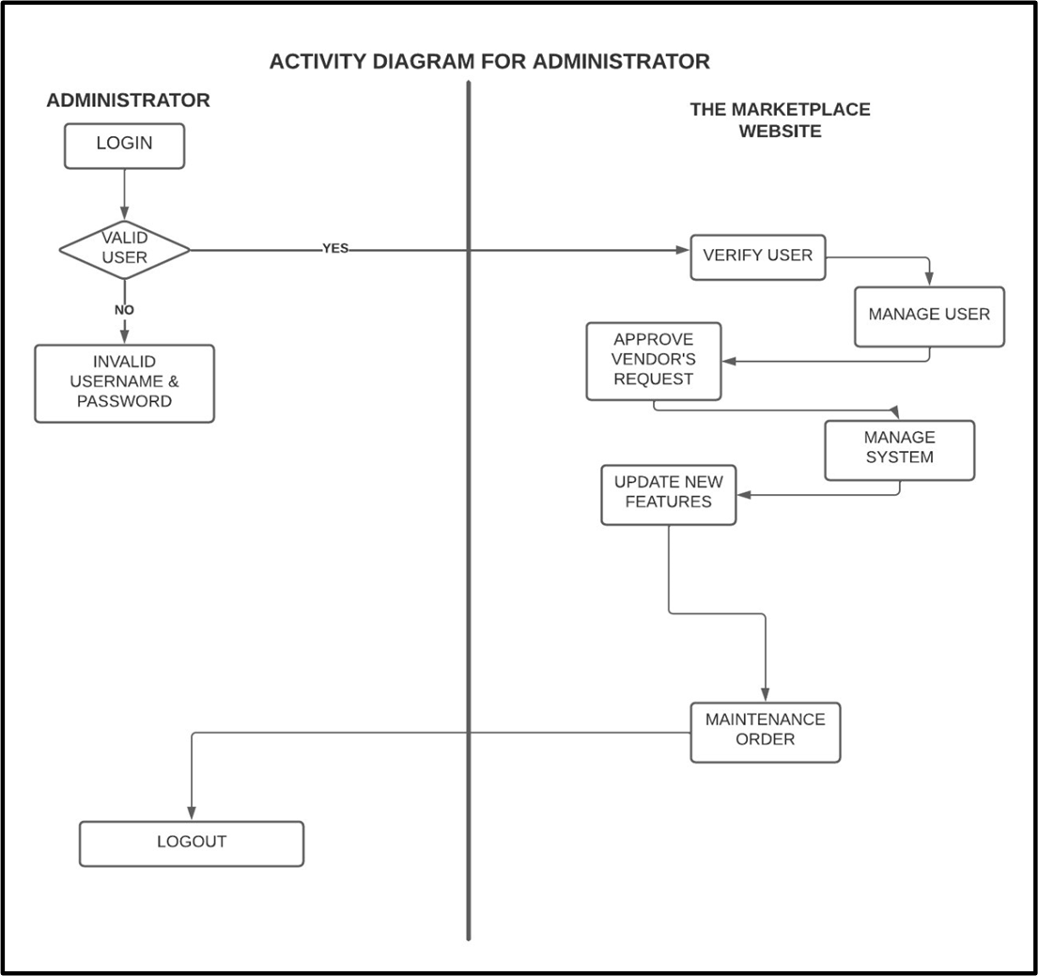
Activity Diagram For Admin

Slide 10
Seller Module
Login of Seller
The system will allow the Seller to add/edit/remove the products
The system will allow the Seller to display their product on homepage

Slide 11
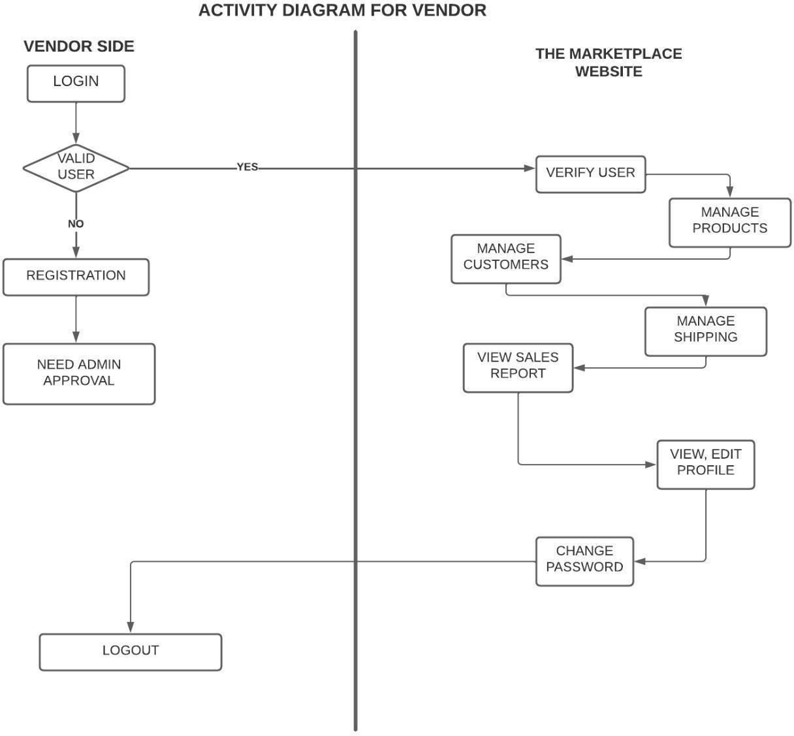
Activity Diagram for sellers

Slide 12
Customer Module
Login of Customer
The system will allow Customer to add/remove products to his cart
The system will allow the Customer to view his/her order summary
The system will allow the Customer to view the product on homepage without login

Slide 13
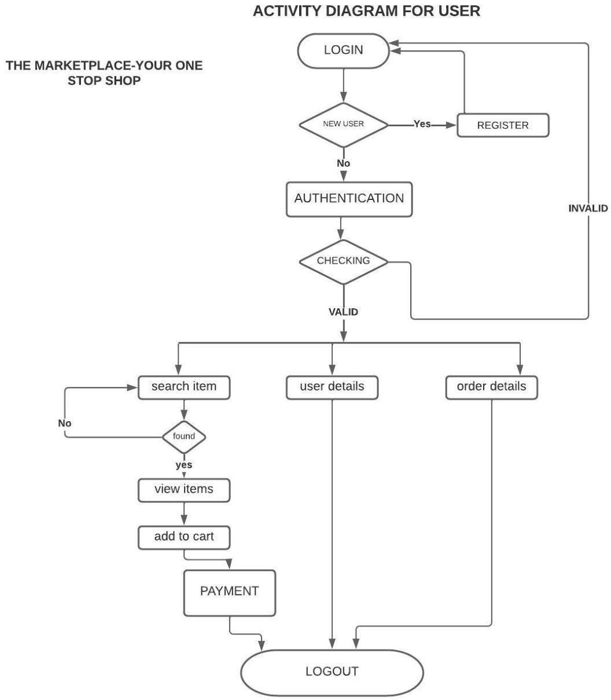
Activity Diagram For Customer

Slide 14
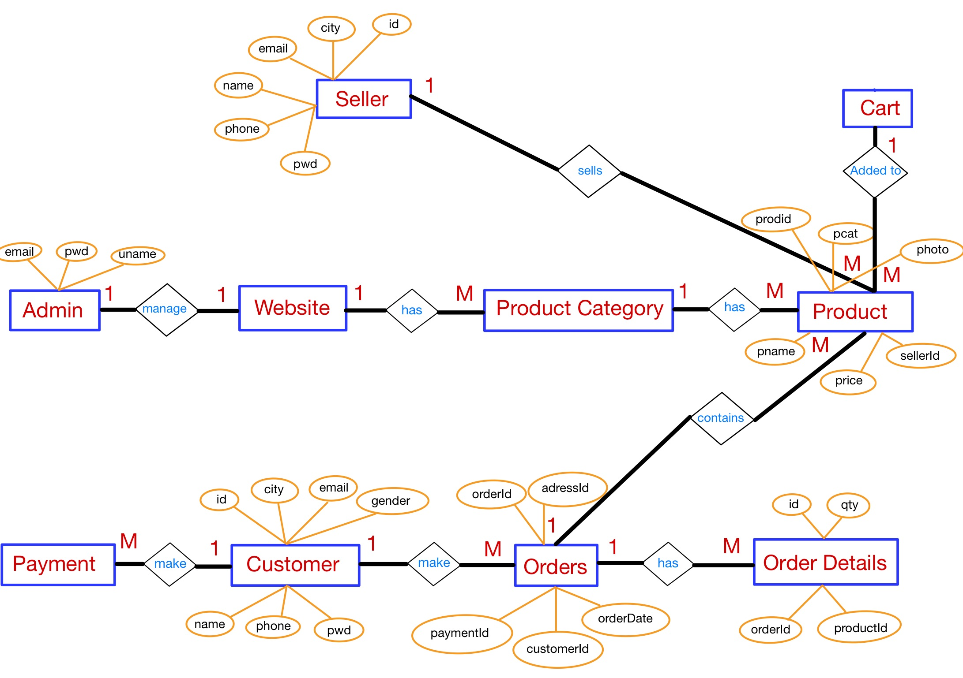
ER Diagram

Slide 15
Project Design

Slide 16
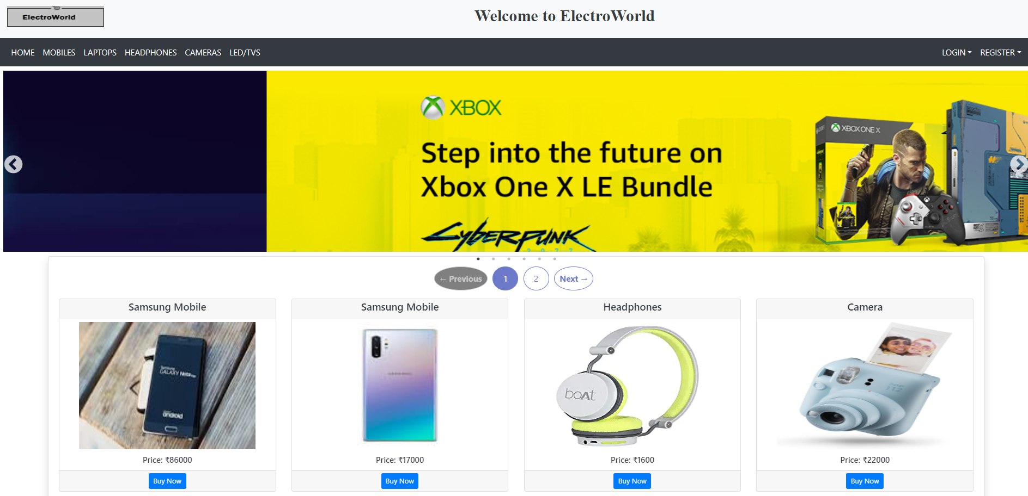
Homepage

Slide 17
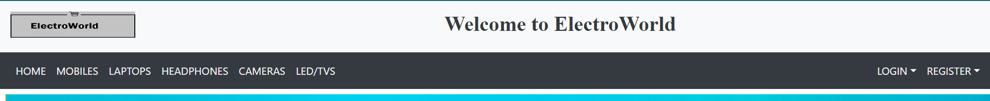
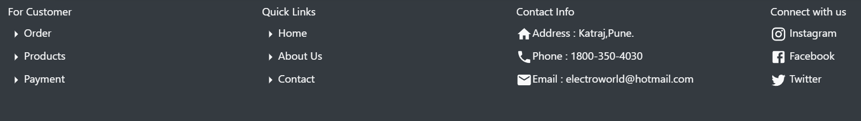
Header and Footer

Slide 18
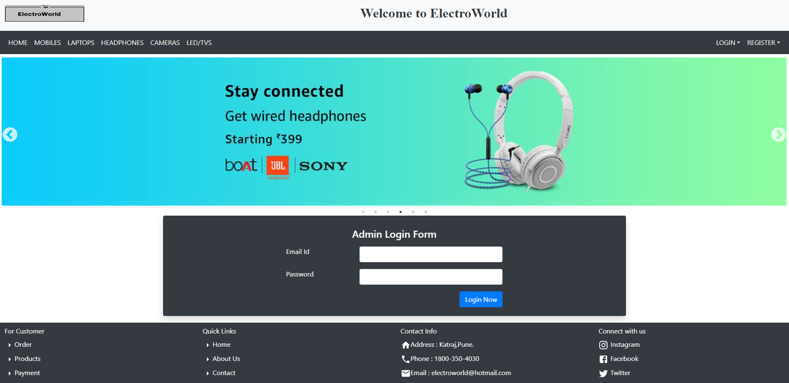
Admin Login

Slide 19
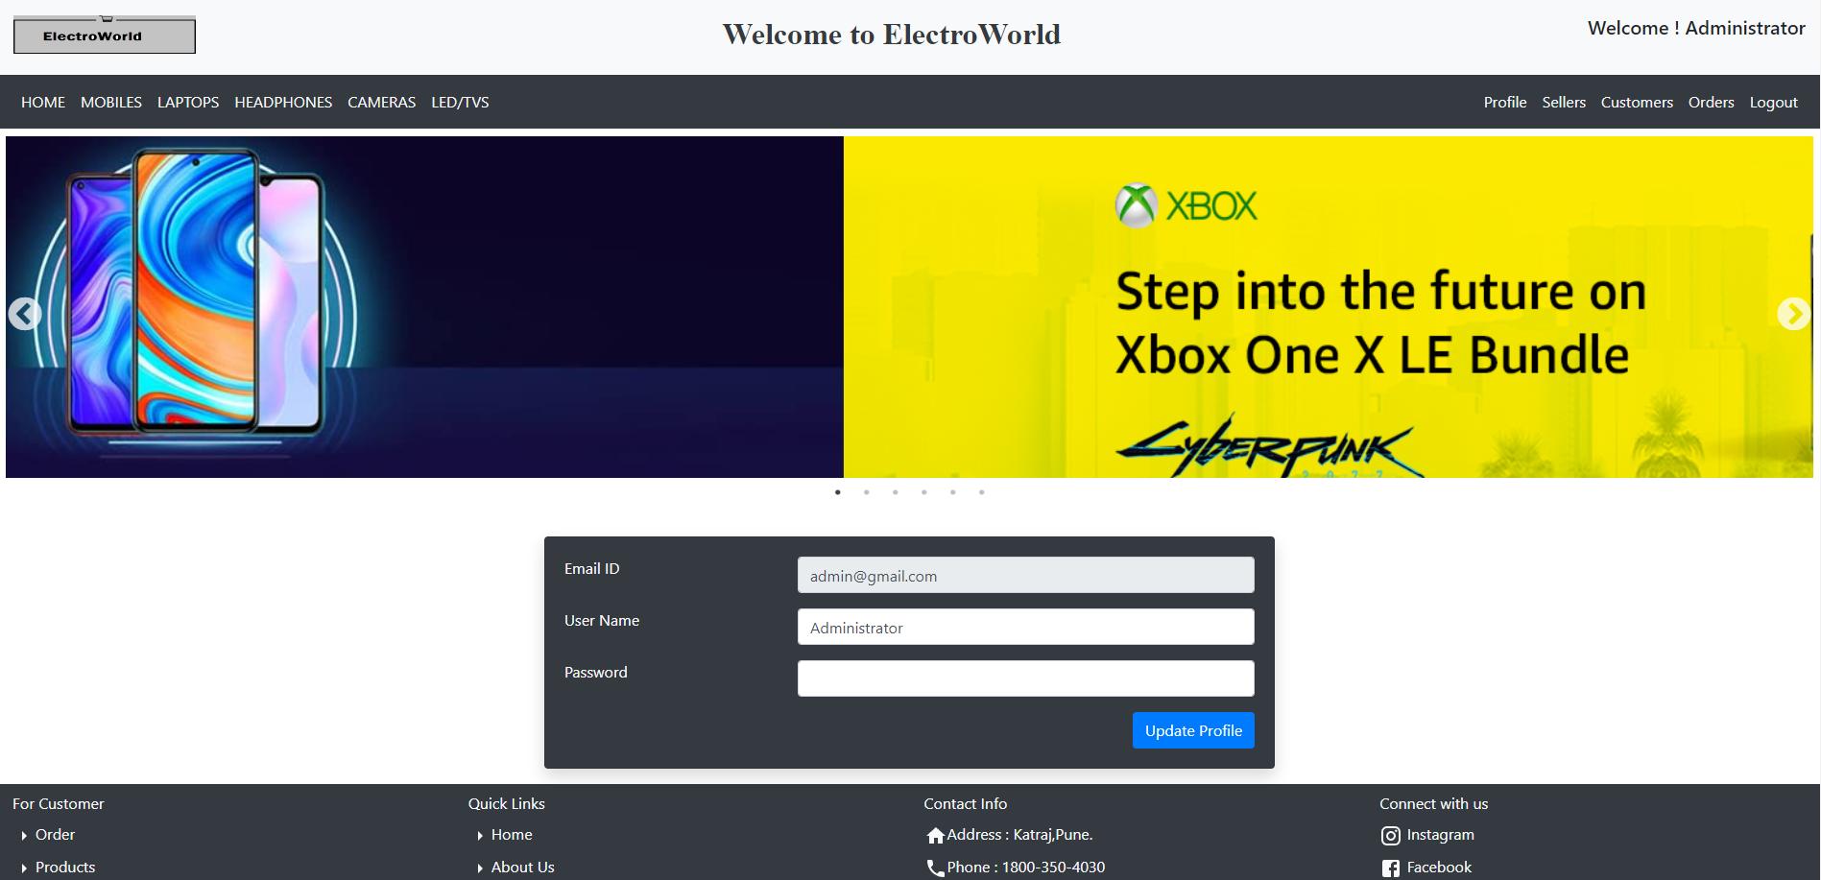
Admin Profile

Slide 20
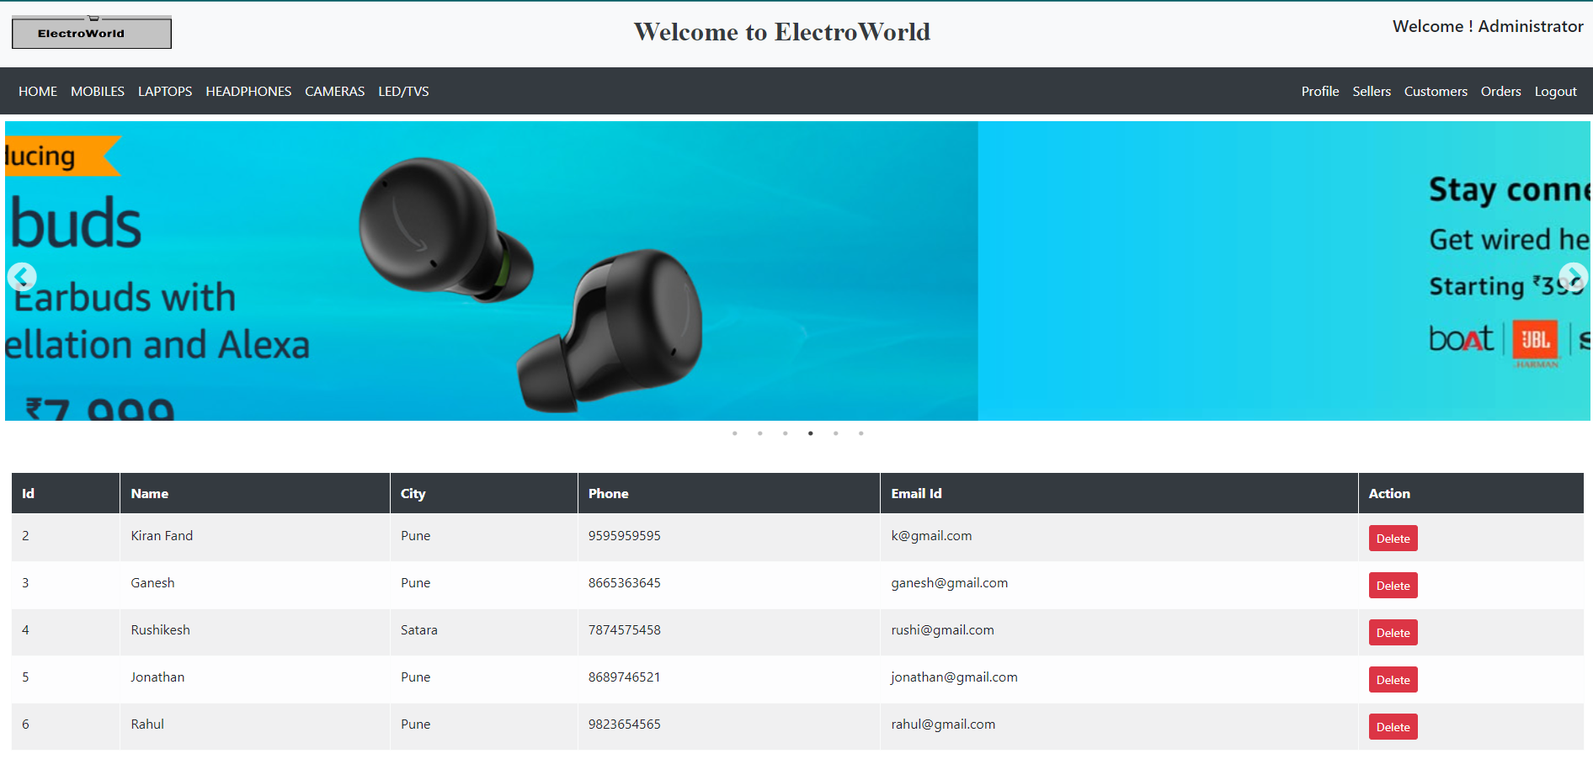
All Registered Sellers

Slide 21
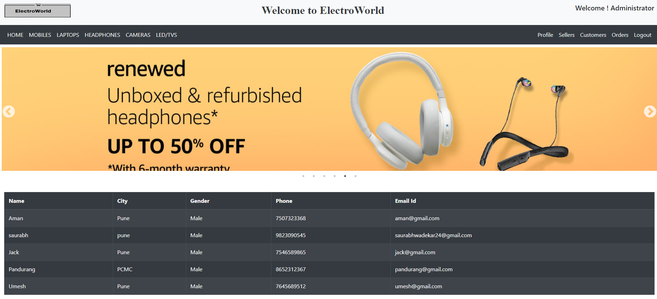
All Registered Customers

Slide 22
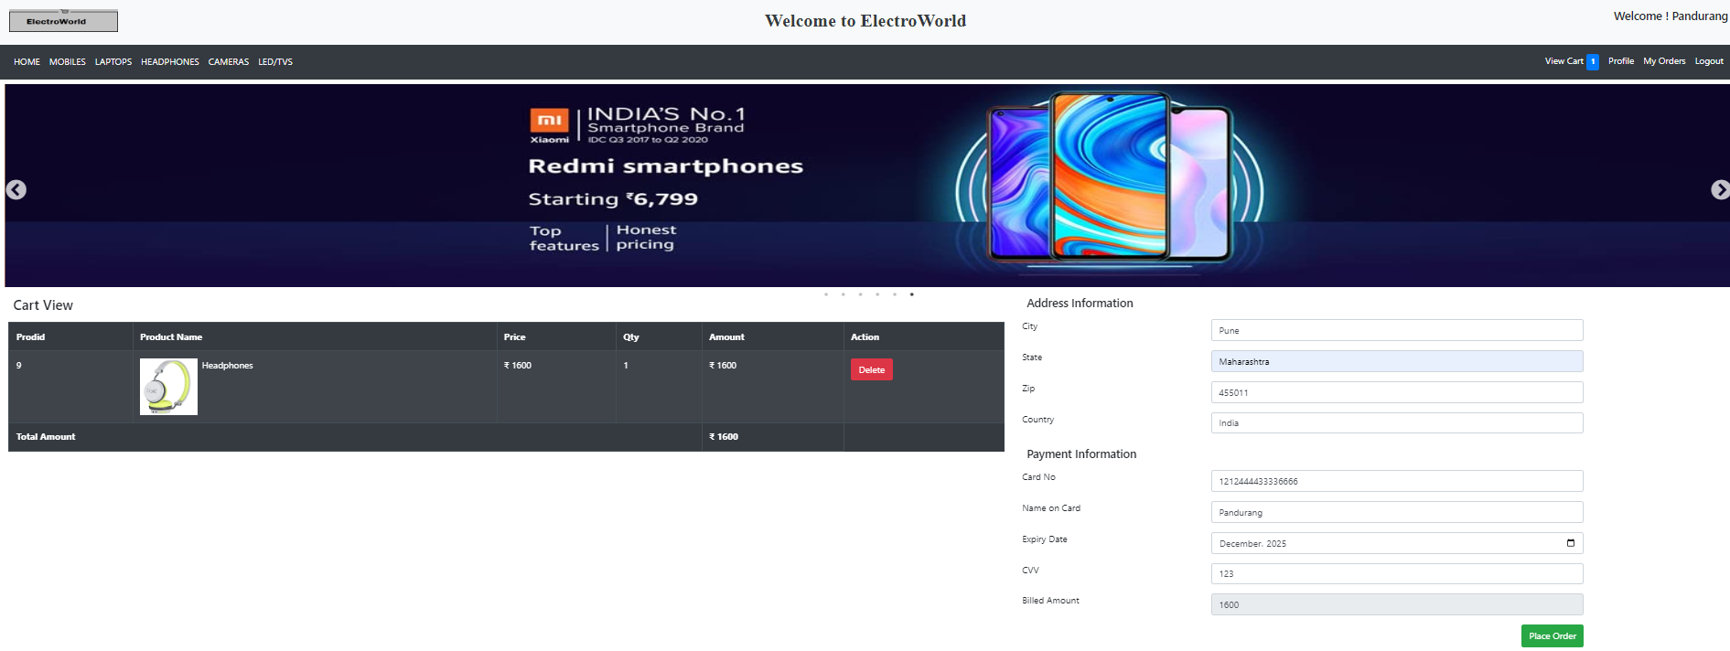
Order Details

Slide 23
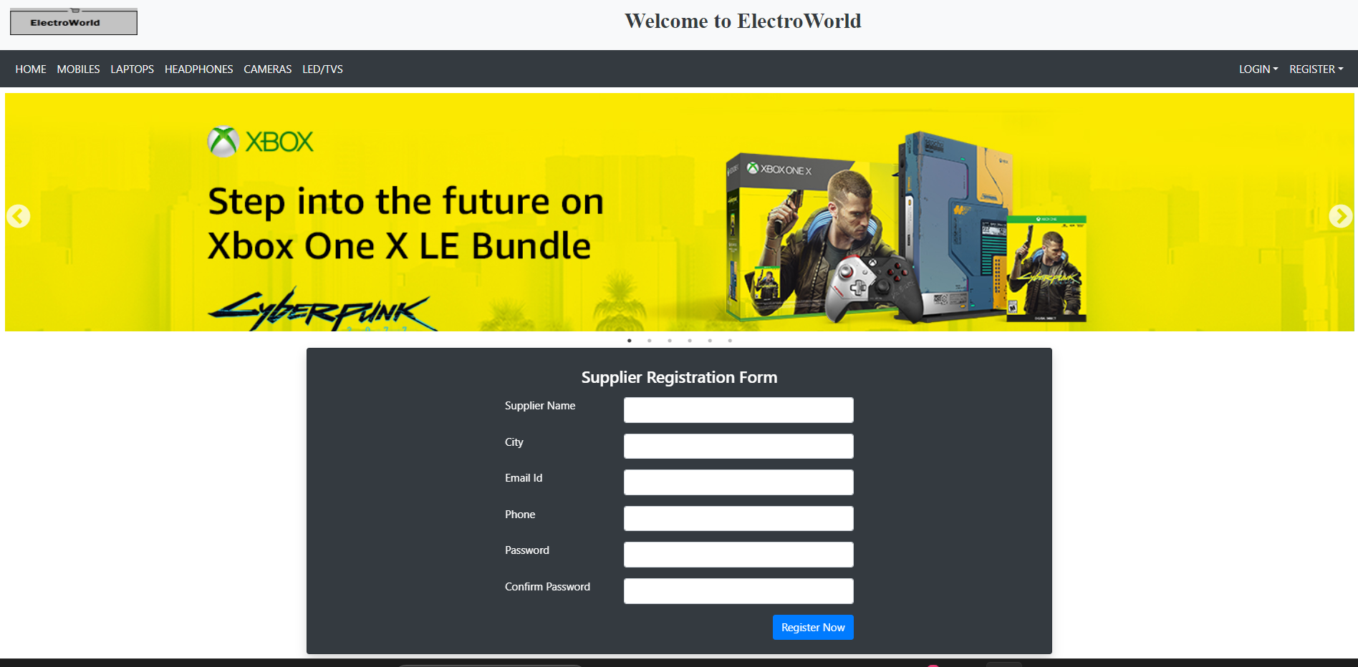
Seller Registration

Slide 24
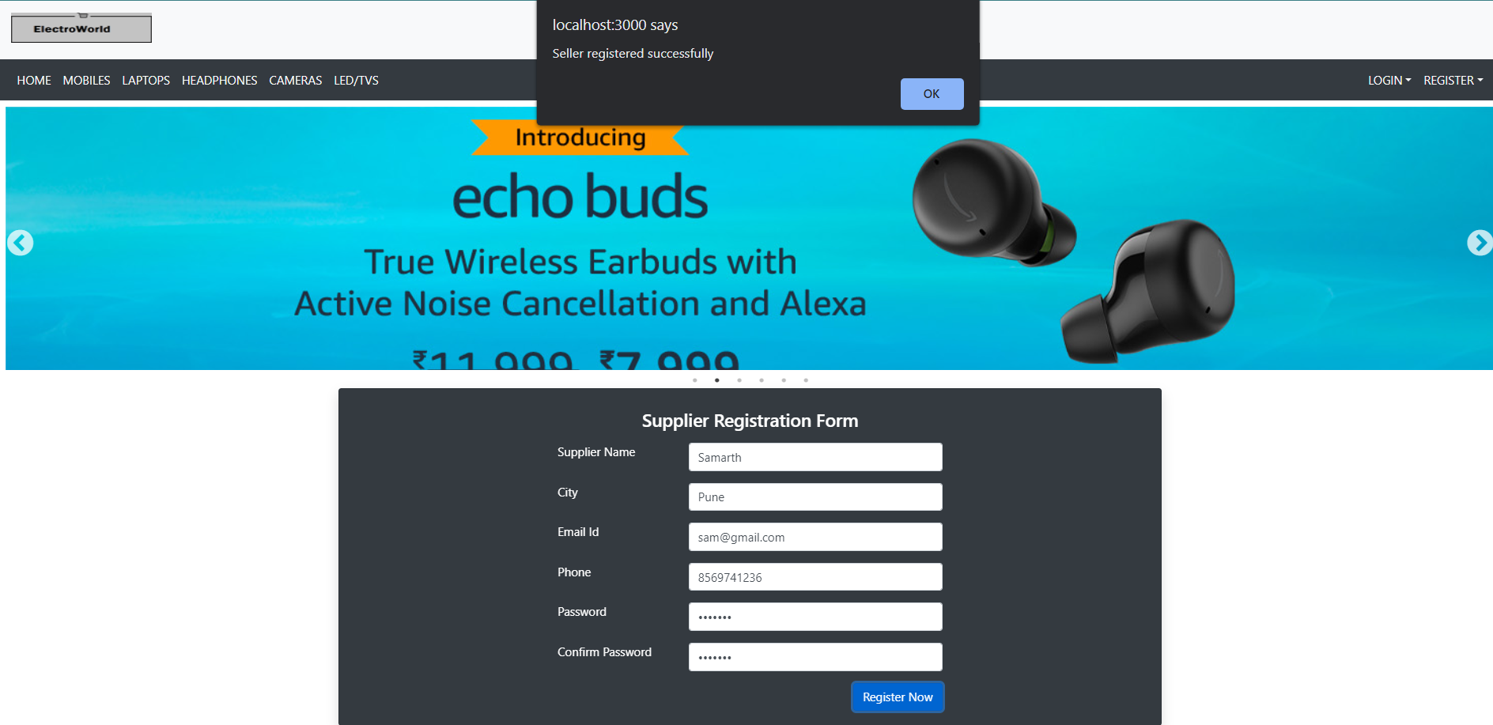

Slide 25
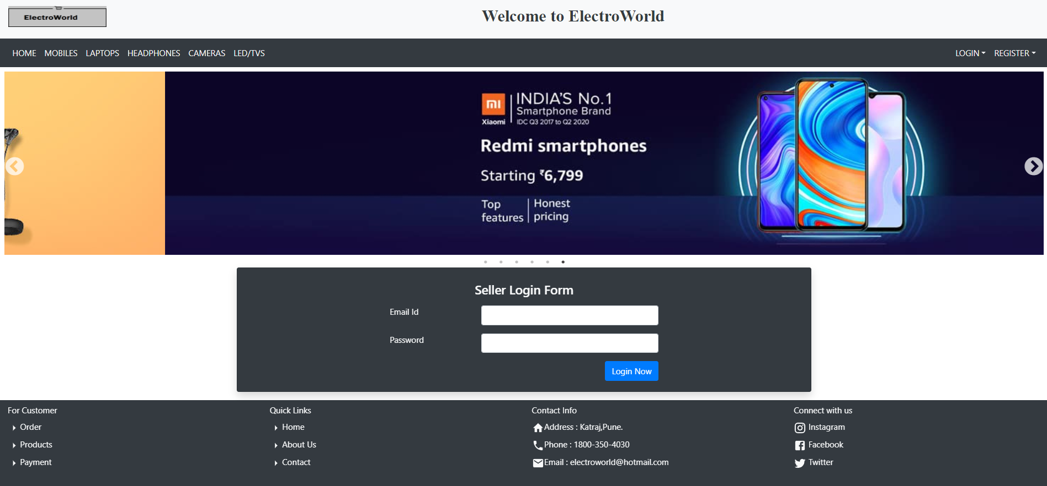
Seller Login

Slide 26
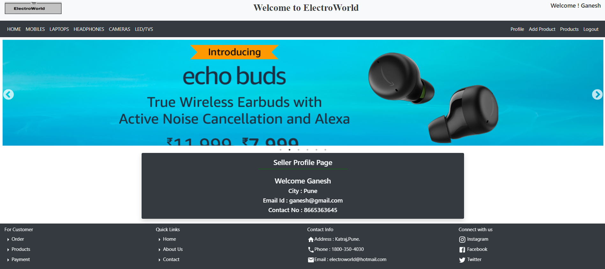
Seller Profile

Slide 27
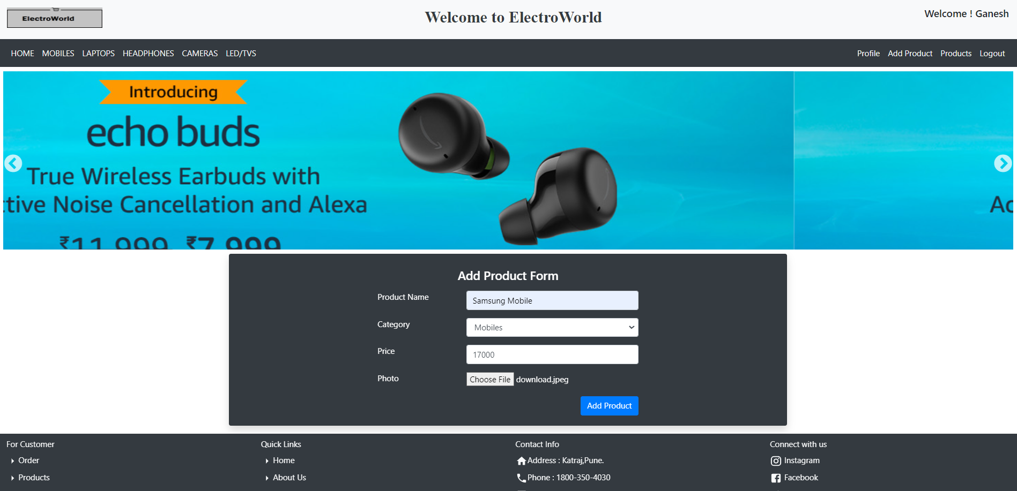
Add Product Form

Slide 28
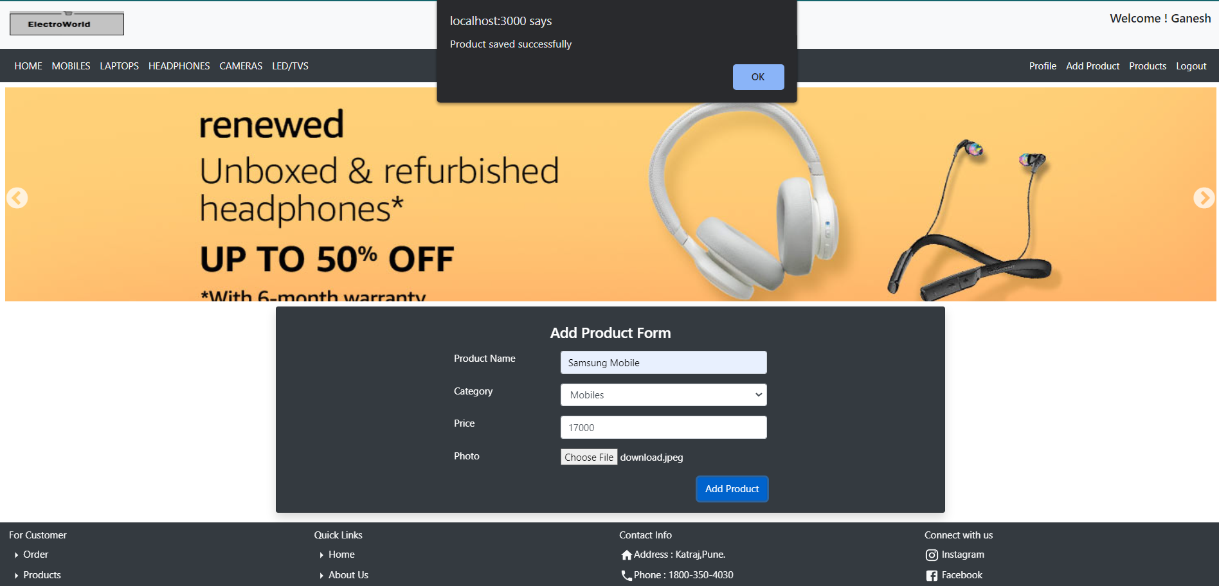

Slide 29
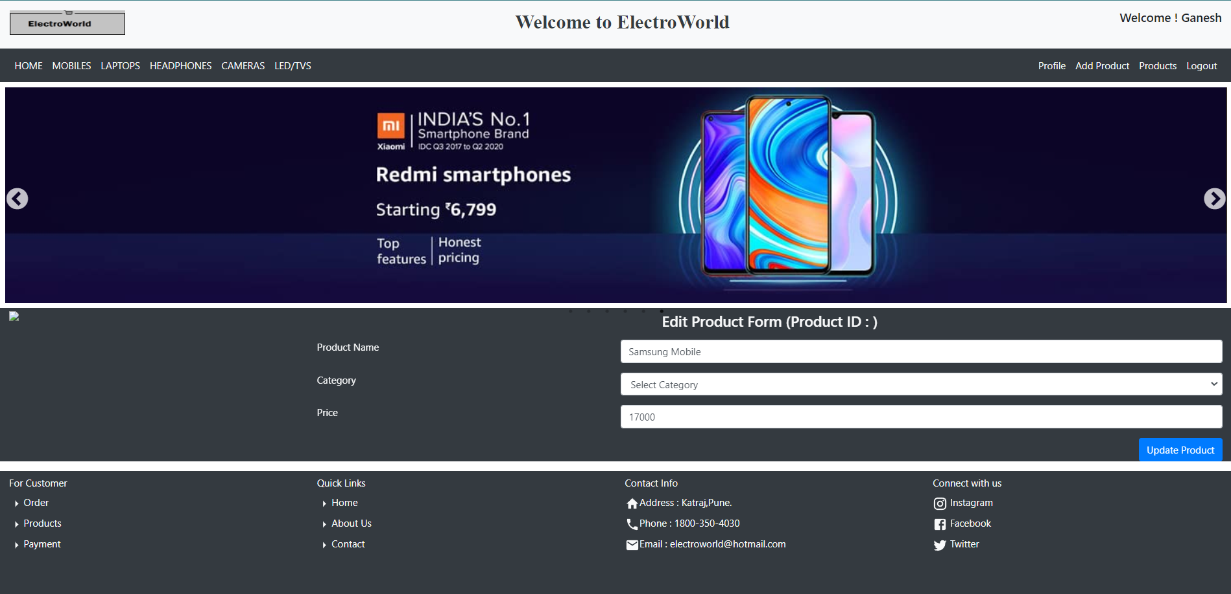
Edit Product

Slide 30
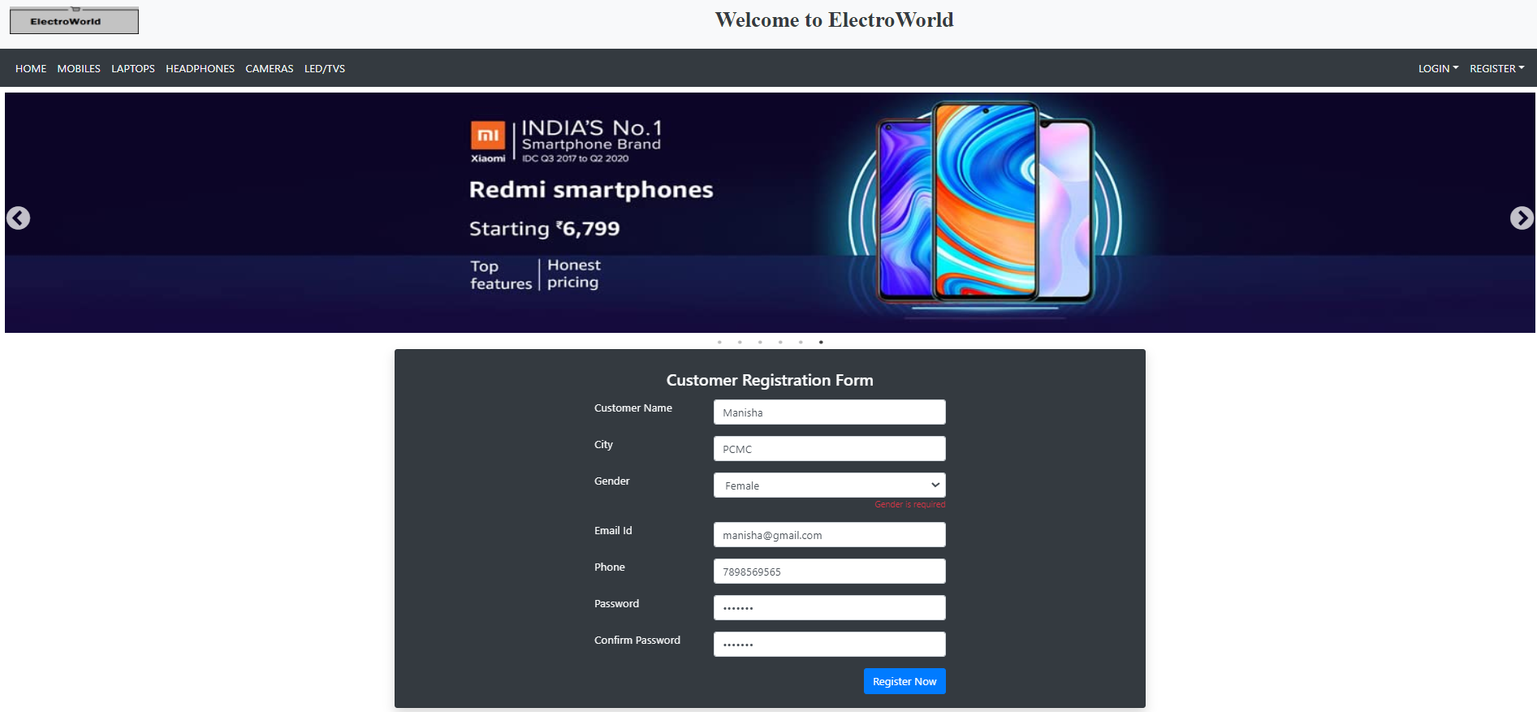
Customer Registration

Slide 31
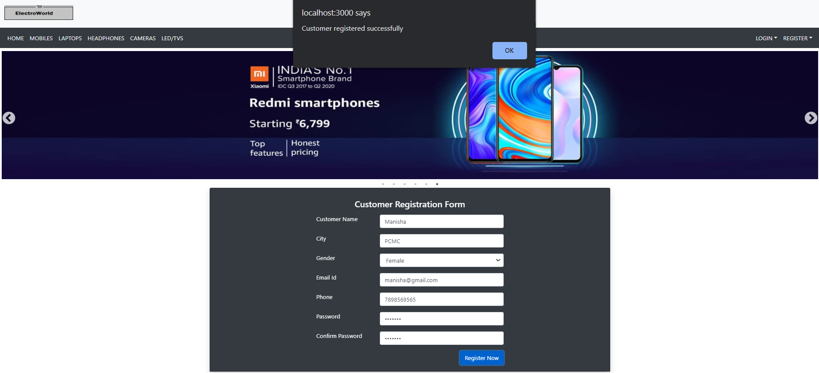

Slide 32
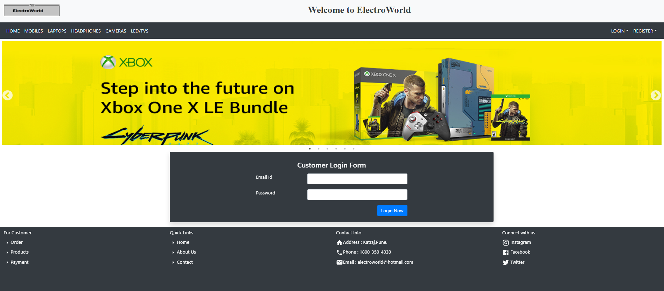
Customer Login

Slide 33
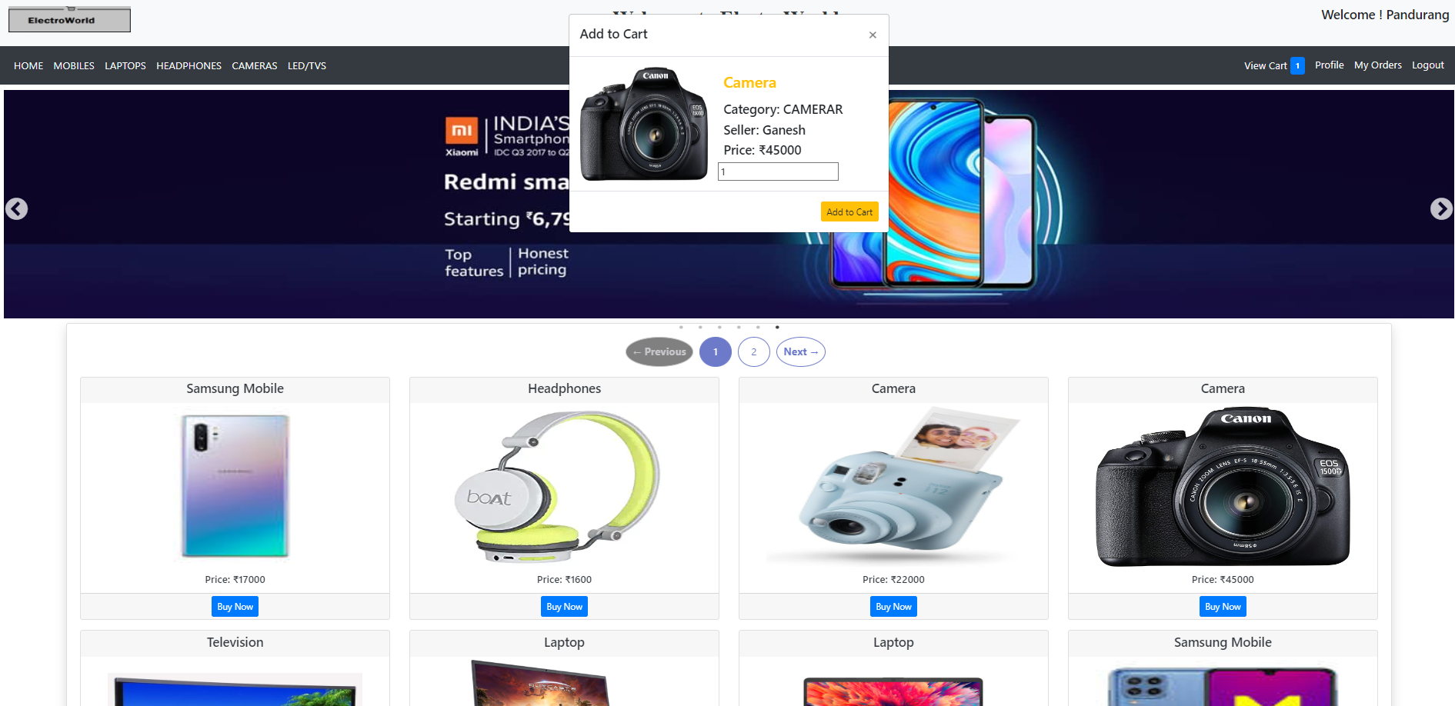
Add To Cart

Slide 34
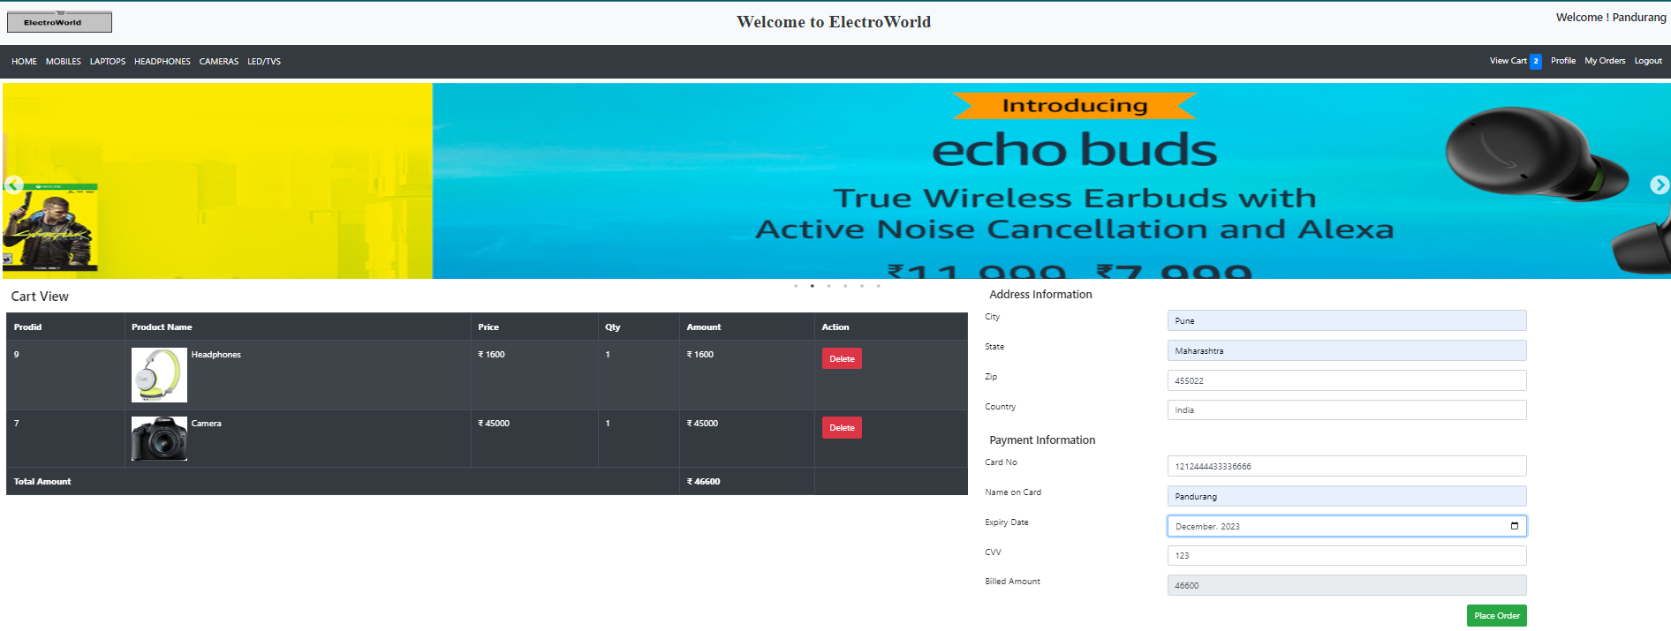
Cart View , Address and Payment Info

Slide 35
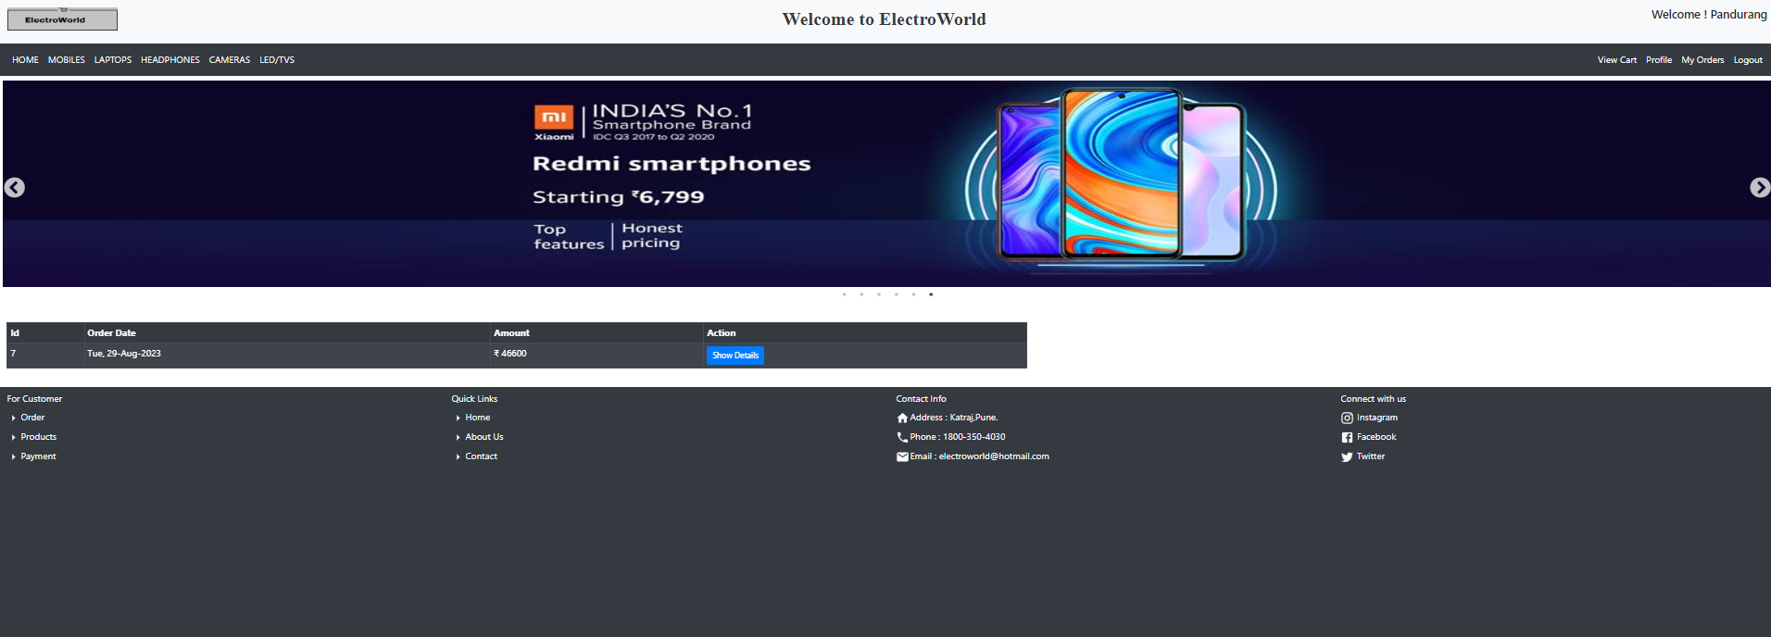
Placed Order Details

Slide 36
Thank -You

